Slide 1
Database
Management Systems
Lecture - 5

Slide 2
Lecture’s Overview
Database Application Development Process
Preliminary Study of System

Slide 3
Database Application Development Process
Involves
Database Design
Application Programs
Implementation

Slide 4
Database Design
A DB Design is a model of a particular real-world system
It provides a picture of reality
Should be simple and self- explanatory

Slide 5
Database Development Process

Slide 6
Database Development Process
Similar to software development process
Preliminary Study
Requirement Analysis
DB Design
Physical Design
Implementation
Maintenance

Slide 7
Design Stages
Analyze User Environment
Develop Conceptual Model
Map Conceptual Model to Logical
Choose DBMS
Develop Physical Design
Implement System
Test System
Operational Maintenance

Slide 8
Analyze Existing System
Objective: To understand the working of existing system
Analyze users’ requirements

Slide 9
Tool Used
Why to use at all?
Data Flow Diagrams

Slide 10
Data Flow Diagrams

Slide 11
Data Flow Diagrams (DFDs)
Represent the flow of data between different processes within a system

Slide 12
Data Flow Diagrams
Simple & intuitive, not focusing on details
To describe, what users do, rather than what computers do

Slide 13
Data Flow Diagrams
Limitations
  Focus only on flows of information
  Decision points/basis not included

Slide 14
DFD-Symbols
Dataflows: pipelines through which packets of information flow. Arrows are labeled with name of the data that moves through

Slide 15
DFD-Symbols
Data Store
  Repositories of data in system
  Static data
  Data held for processing
  Name is a noun phrase

Slide 16
DFD-Symbols
Process
transforms incoming data flow into outgoing data flow
OR

Slide 17
DFD-Process
Numbered
Name is verb/object phrase;
Noun for high-level systems
1.0
1.0
Process
OR
Process

Slide 18
DFD-Symbols
External Entities
Sources/destinations for data
Outside the system
Name is Noun Phrase

Slide 19
DFD-Symbols
Collector
Several data flows combine here
No processing occurs here

Slide 20
DFD-Symbols
Separator
Several data flows split from here
No processing

Slide 21
DFD-Symbols
  Ring-sum operator
Shows two possible data flows
Only one is followed

Slide 22
DFD-Symbols
AND operator
Shows two data flows
Both are followed

Slide 23
Types of DFD
Context diagram
Level 0 diagram
Detailed diagram

Slide 24
Context Diagram
Consists of single Process/System
Represents the system/process being analyzed
Name: Usually a Noun phrase

Slide 25
Context Diagram
Show Context Only
Inputs/outputs
External Entities
No Data Stores
No flows between external entities

Slide 26
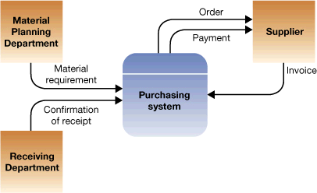
Context Diagram

Slide 27
Context Diagram
Student
Dean
Class Counts
Class Requests
Faculty Load Sheets
Schedule
Admission
System
Course Offerings
Class Lists
Student Data
Registrar
Faculty
Member

Slide 28
Diagram 0
Class
Requests
1.0
Process
Requests
Old Class Data
Class
Registration
Student
C
Request
Status
Updated
Class Data
2.0
Produce
Student
Schedule
Updated
Student
Data
7.0
Produce
Faculty
Load
Sheets
Student
Registration
S
5.0
Produce
Class
Lists
6.0
Produce
Class
Counts
3.0
Create
Student
File
4.0
Create
Class
File
Student
Data
Faculty
member
Registrar
Course
Offering
Dean

Slide 29
That is all for lecture 5, however,
Due to time available discussed
Level 0 diagram in air, to be included
Later inshAllah

Slide 31
Student
Dean
Class Counts
Class Requests
Faculty Load Sheets
Schedule
Admission
System
Course Offerings
Class Lists
Student Data
Registrar
Faculty
Member

Slide 33
Diagram 0
Class
Requests
1.1
Process
Requests
Old Class Data
Class
Registration
Student
C
Invalid
Request
Updated
Class Data
2.0
Produce
Student
Schedule
Updated
Student
Data
7.0
Produce
Faculty
Load
Sheets
Student
Registration
S
5.0
Produce
Class
Lists
6.0
Produce
Class
Counts
3.0
Create
Student
File
4.0
Create
Class
File
Student
Data
Faculty
member
Registrar
Course
Offering
Dean

Slide 34
Detailed Diagram
Class
Registration
C
Old Class
Data
Class
Requests
1.1
Edit
Requests
1.2
Check
Class
Counts
Student
Updated Class Data
Invalid
Request
Valid
Requests
Rejected Request
Accepted Request
Accepted Request
1.4
Update
Class
Data
1.3
Update
Student
Data
Student
Registration
S

Slide 35
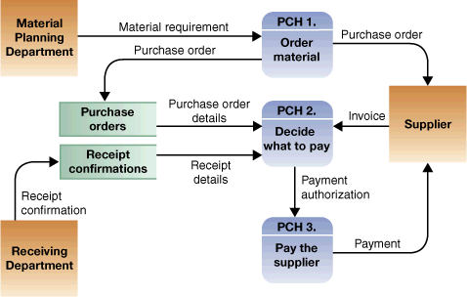

Slide 36
Overview
Continue discussion on DFD
Discussion on Design Phase
Database Design and Data Models

Slide 37
Database
Management Systems
Lecture - 5

